Slide 1



SUPERMARKET SALES ANALYSIS
Profit | Product | Performance

Slide 2
01 / BUSINESS CONTEXT
Project Overview
Business Problem
DATASET TIMELINE
Unclear profit margins across regional retail branches.
2015–2017
Analytical Objective
Build SQL Star Schema for Power BI insights.
Supermarket retail transactions across India.
Validated Scope
9,994 verified orders across 97 Indian locations.

Slide 3

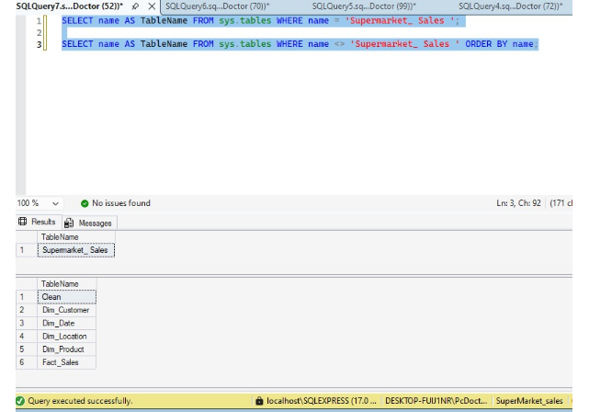
02 / SQL SERVER DATA CLEANING
Step 1: Check Table Name
SELECT name FROM sys.tables WHERE name = 'Supermarket__Sales';
Result: Supermarket__Sales
Catalog Verification
Confirmed exact table name alongside 6 warehouse tables.

Slide 4

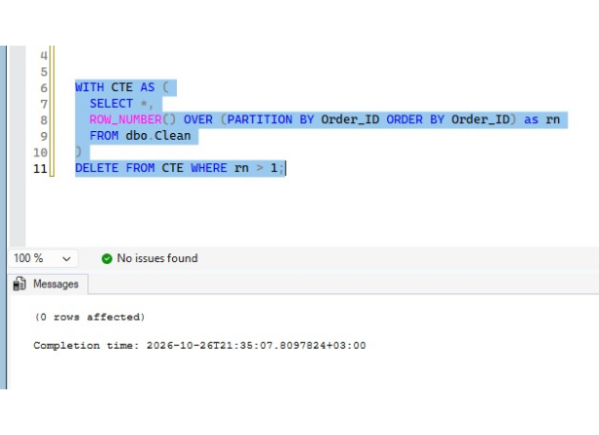
03 / SQL SERVER DATA CLEANING
Step 2: Remove Duplicates
WITH CTE AS (SELECT *, ROW_NUMBER() OVER (PARTITION BY Order_ID ORDER BY Order_ID) as rn FROM dbo.Clean)
DELETE FROM CTE WHERE rn > 1;
0 rows affected
Zero duplicate Order_ID records found in dbo.Clean.

Slide 5
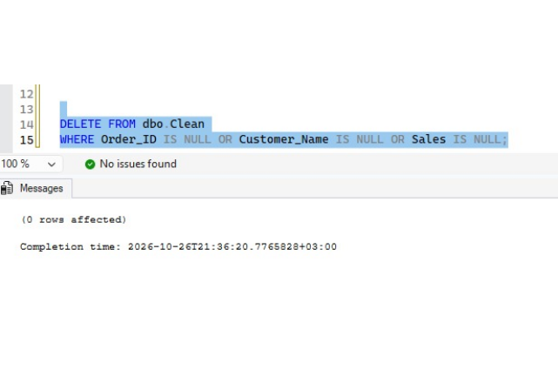
04 / SQL SERVER DATA CLEANING
Step 3: Remove NULLs
DELETE FROM dbo.Clean WHERE Order_ID IS NULL OR Customer_Name IS NULL OR Sales IS NULL;
0 rows affected
9,994 Verified Rows
Complete data integrity across all mandatory fields.

Slide 6

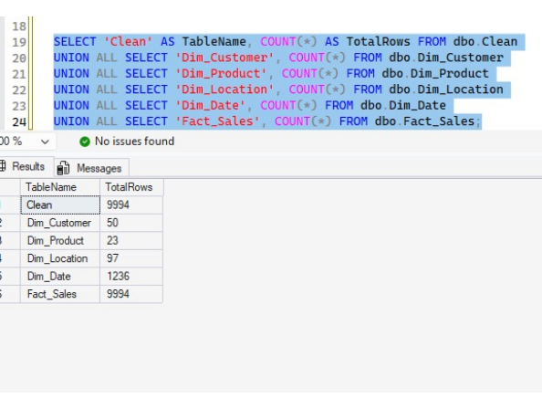
05 / DATA WAREHOUSE ARCHITECTURE
Data Warehouse Model Counts
SELECT 'Clean' AS TableName, COUNT(*) FROM dbo.Clean UNION ALL SELECT 'Fact_Sales', COUNT(*) FROM dbo.Fact_Sales;
Table Name | Role | TotalRows
Clean | Staging | 9,994
Dim_Customer | Dimension | 50
Dim_Product | Dimension | 23
Dim_Location | Dimension | 97
Dim_Date | Dimension | 1,236
Fact_Sales | Fact Table | 9,994

Slide 7

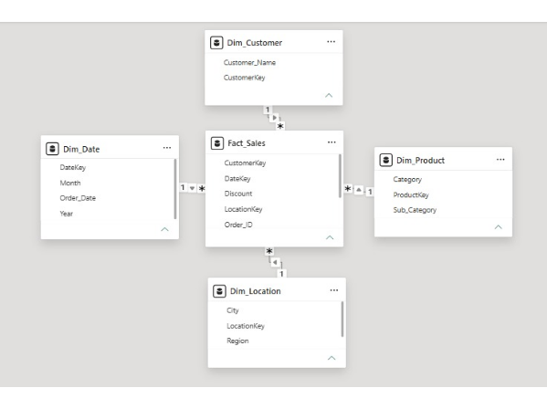
06 / DATA MODELING
Star Schema Architecture
Dim_Customer (1)
Fact_Sales (*)
Dim_Date (1)
Dim_Product (1)
Keys, Order_ID, Discount
Dim_Location (1)

Slide 8

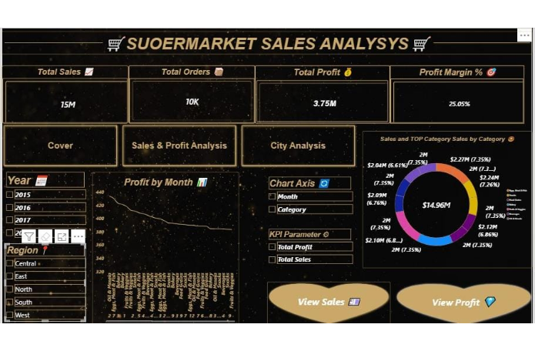
07 / POWER BI EXECUTIVE OVERVIEW
Sales & Profit Analysis Dashboard
TOTAL SALES
15M ($14.96M)
TOTAL ORDERS
10K Orders
TOTAL PROFIT & MARGIN
3.75M (25.05%)

Slide 9

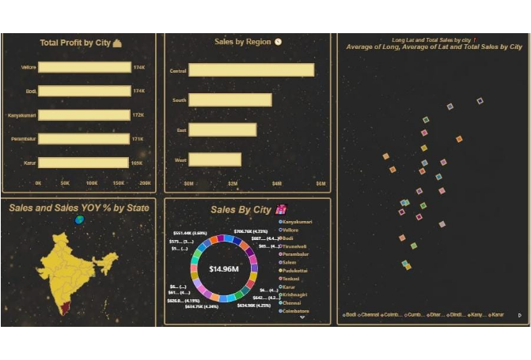
08 / GEOGRAPHIC PERFORMANCE
City & Region Analysis
TOP REGION
Central (5M+)
Highest regional revenue across India.
TOP CITIES BY PROFIT
Vellore & Bodi
174K profit each in city rankings.

Slide 10

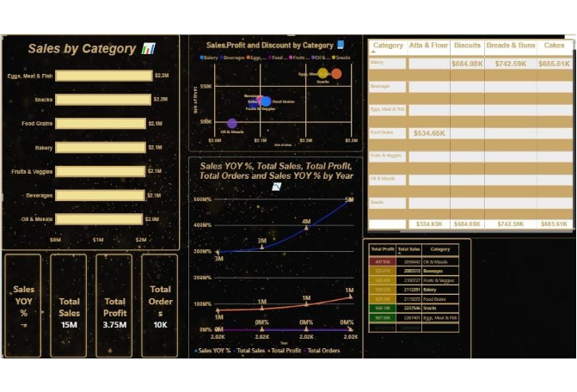
09 / PRODUCT PERFORMANCE
Category Analysis Dashboard
#1 PRODUCT CATEGORY
Eggs, Meat & Fish
$2.3M Total Sales
#2 PRODUCT CATEGORY
Snacks
$2.2M Total Sales

Slide 11
10 / ANALYTICAL FINDINGS
Key Sales Insights
Central Region Dominance: Generates over 5M in total revenue.
Top Profit Hubs: Vellore and Bodi yield 174K profit each.
Category Leadership: Eggs, Meat & Fish leads at 2.3M.
Healthy Margin Stability: Overall profit margin holds at 25.05%.

Slide 12



11 / TECHNICAL STACK
Tools & Technologies Used
SQL Server
Power Query
DAX Measures
Power BI Desktop
Star Schema modeling via CTE cleaning.
Date.FromText using en-GB locale formatting.
Dynamic KPI calculations for profit margins.
Interactive Gold & Black executive visuals.

Slide 13
12 / STRATEGIC ACTION PLAN
Business Recommendations
01
02
03
Cold-Chain Expansion
Replicate Top Models
Discount Calibration
Prioritize Eggs, Meat & Fish inventory.
Apply Vellore & Bodi pricing regionally.
Cap promotional discounts during low months.

Slide 14
THANK YOU
Questions & Discussion
SUPERMARKET SALES ANALYSIS | SQL SERVER & POWER BI

